Slide 1



TECH TITANS
SMART INDIAN HACKATHON
AI DEEP FAKE DETECTTION
PROBLEM STATEMENT: Development of AI/ML-based Solution for Detection of Face-Swap Based Deep Fake Videos

Slide 2

TECH TITANS
TEAM MEMBERS:
P. LALITH PRAKASH (2303A52012)
ZAID KHIZAR (2303A52016)
M. LALITH KUMAR (2303A51761)
B. PRANEETH GOUD (2303A52005)
N. NITHIN VARMA(2303A52011)
ISHA MADEEHA (2303A51017)

Slide 3

TECH TITANS
OVERVIEW
what are deep fakes.?
Deep fakes use AI to create realistic but fake videos by altering someone’s face, voice, or actions.
01
03
Face-Swap Deep Fakes..?
Face-swap deep fakes specifically swap one person’s face with another’s, making it look like someone is saying or doing something they never did.

Slide 4

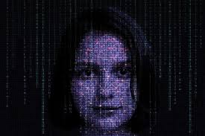
TECH TITANS
why deep fake detection..?
Fake news
Malicious hoaxes
Financial fraud
Celebrity unusual video
Political videos
03

Slide 5
TECH TITANS
TECHNOLOGY AND MODELS USED
3) Advanced Techniques
GANs & Capsule Networks
Adversarial Training
8) Model Training & Evaluation
Metrics & Validation
9) Ethics & Privacy
Ethical & Legal Considerations
10) Implementation Tools
Python Libraries & Development
11) System Integration
Detection Pipeline & Deployment
12) Continuous Learning
Latest AI/ML Advances
4) Image Analysis
Frequency & Spectral Analysis
Error Level Analysis (ELA)
1) IMAGE AND VIDEO PROCESSING
Acquisition & Preprocessing
Feature Extraction
5) Metadata & Forensics
EXIF Data & Biometric Analysis
2) Deep Learning Essentials
Neural Networks & CNNs
RNNs & LSTMs
6) Ensemble & Hybrid Models
Combining Multiple Techniques
7) Data Handling
Dataset Collection & Augmentation

Slide 6
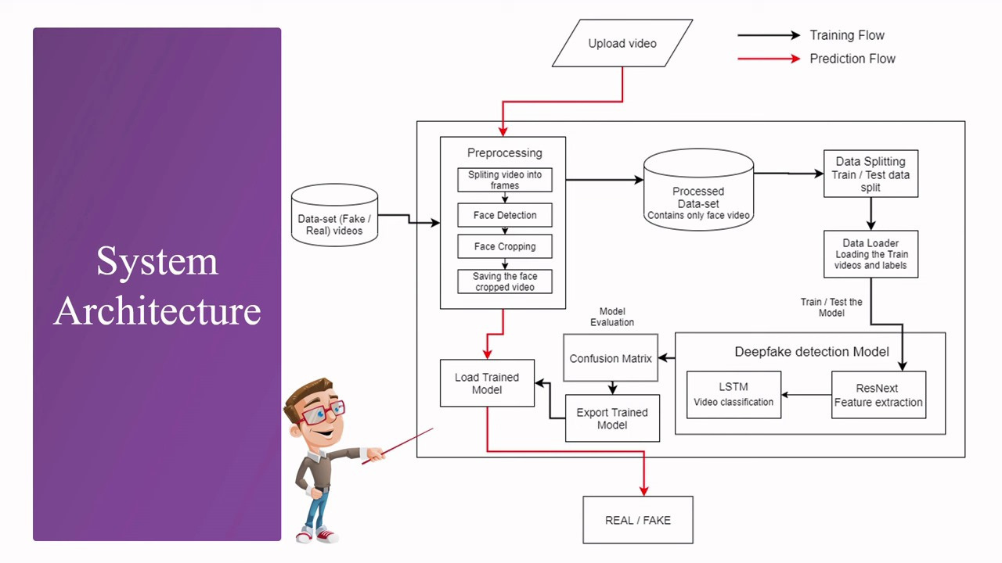
TECH TITANS
MODEL ARCHITECTURE
01
02

Slide 7

TECH TITANS
OUR MISSION
our mission is to authenticate face-swap deep fake videos and generate detailed reports on abnormalities, including the mathematical techniques used in their creation. This involves employing methods such as frequency analysis, error level analysis (ELA), image metadata analysis, adversarial training, spectral analysis, biometric analysis, and ensemble methods to detect and understand image manipulations and deep fakes.
01
02
03

Slide 8
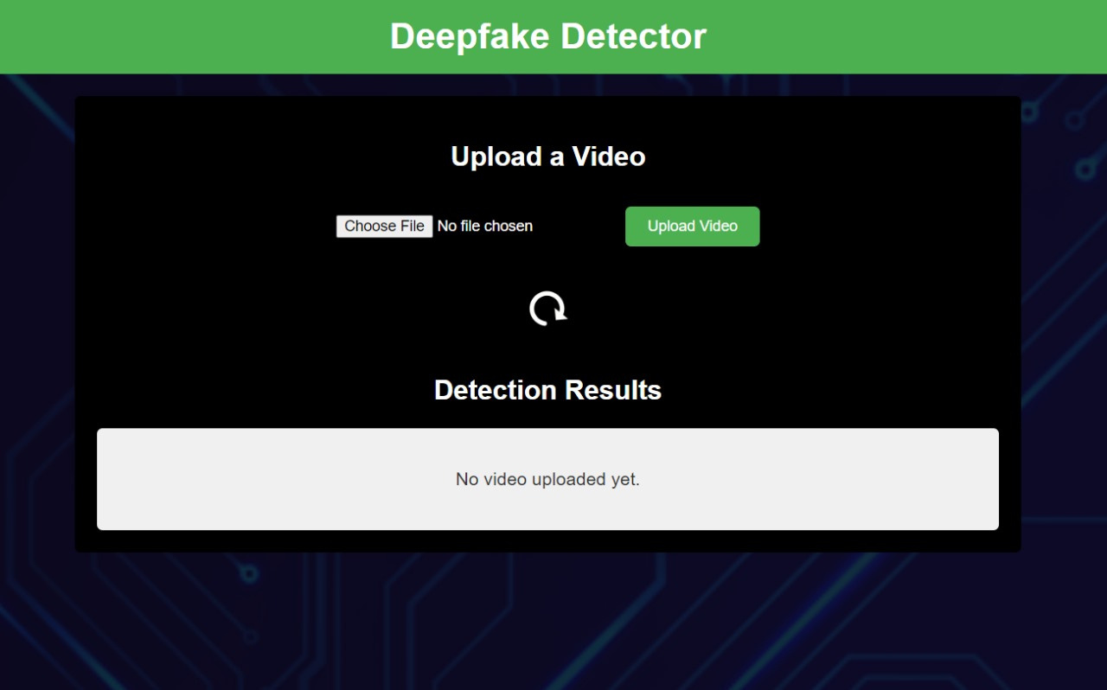
TECH TITANS

Slide 9
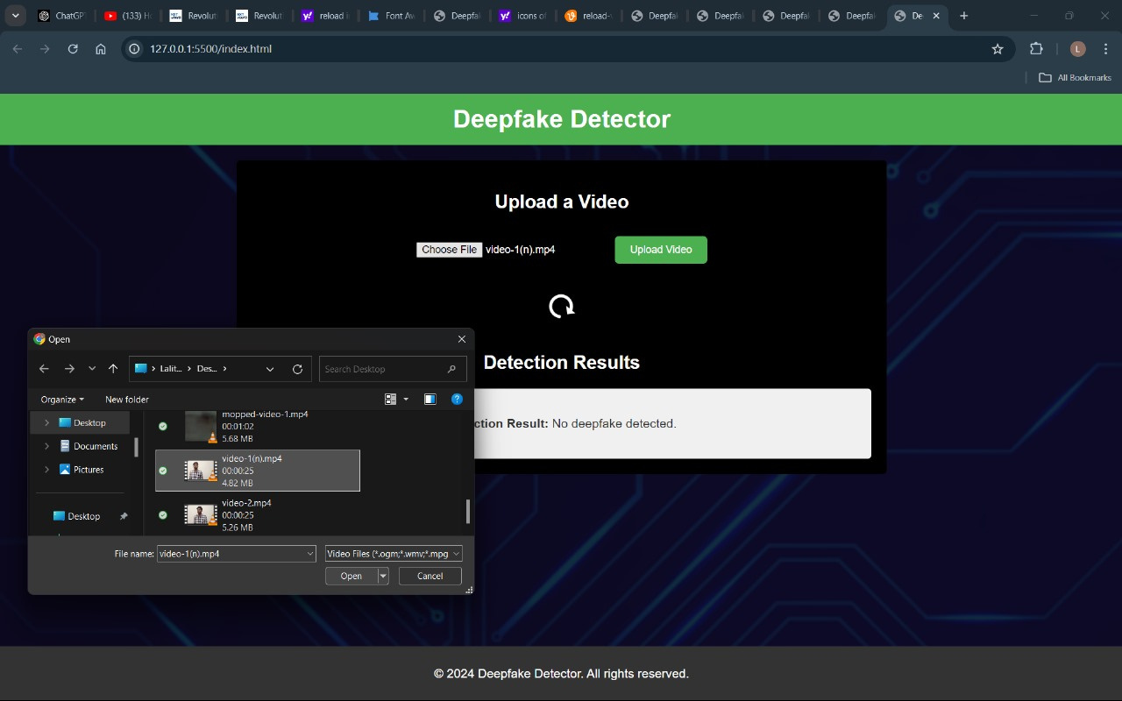
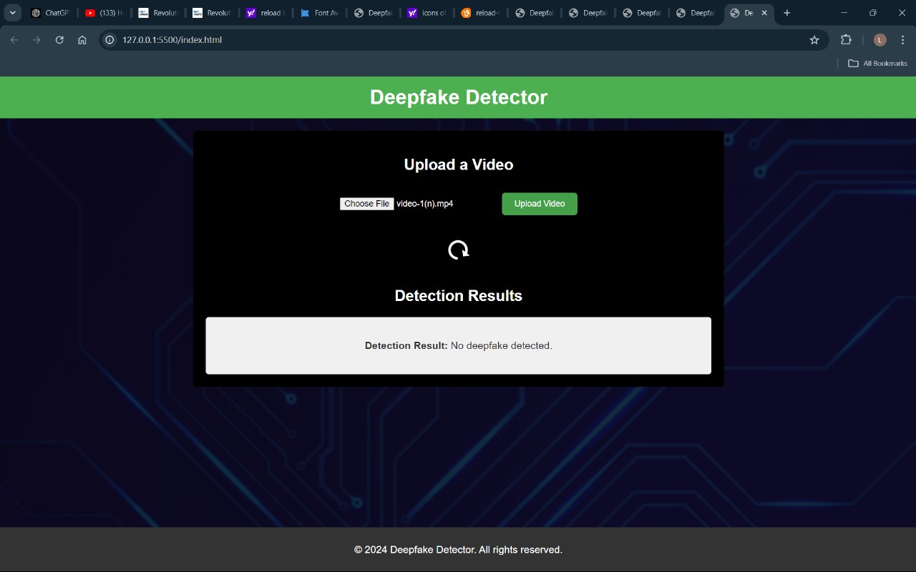
TECH TITANS

Slide 10

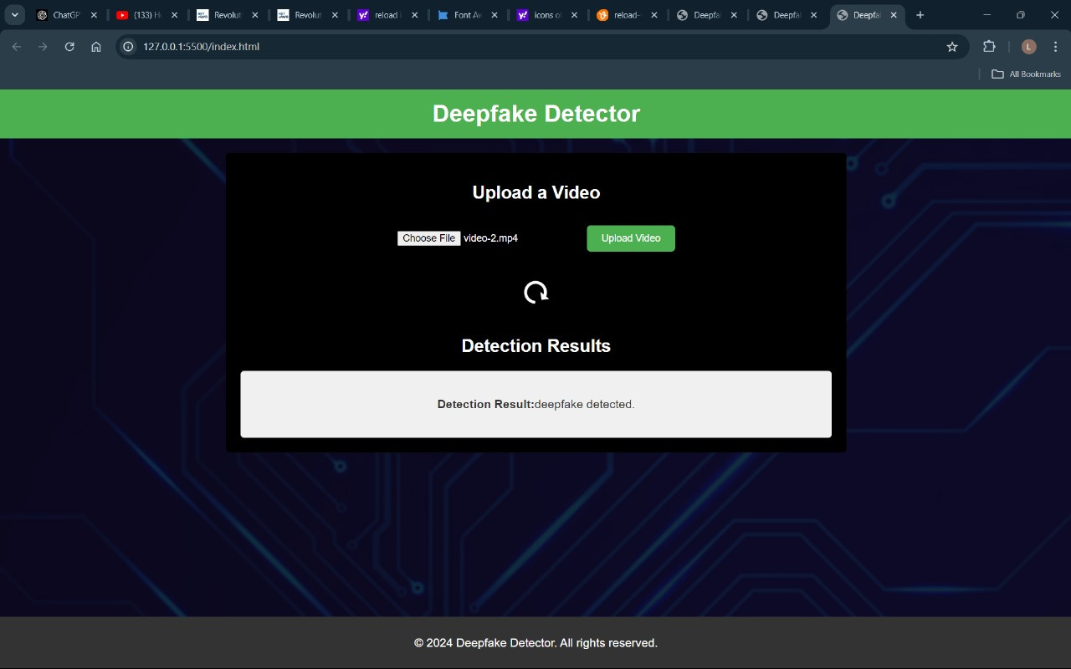
TECH TITANS

Slide 11
TECH TITANS
Applicability:
Frequency Analysis: Effective for detecting abnormal frequency components in GAN-generated images, useful for identifying artifacts that are not present in natural images.
Error Level Analysis (ELA): Focuses on localized image manipulations, helping to pinpoint areas that have been altered.
Adversarial Training: Increases robustness against sophisticated generative models, making detection methods more resilient.
Biometric Analysis: Targets inconsistencies in biometric features like facial landmarks or skin texture, which are often difficult for deepfake models to replicate accurately.
Ensemble Methods: Combines multiple detection techniques to improve overall accuracy, leveraging the strengths of each method.

Slide 12
Sustainability
Your paragFrequency Analysis: Effective but requires updates as new generative models evolve.
Error Level Analysis (ELA): Sustainable but may need adaptations to keep up with new image editing tools and techniques.
Adversarial Training: Highly sustainable, as it can be continually updated to counter new generative techniques.
Biometric Analysis: Generally stable, but could face new challenges as deepfake models improve in replicating biometric details.
Ensemble Methods: Highly adaptable and improves with the integration of new detection methods and technologies, making it a sustainable approach.
This analysis seems well-rounded, covering the strengths, challenges, and long-term considerations of each method. If you're looking for further insights or need help integrating these into your hackathon project, feel free to ask!raph text

Slide 13
Feasibility
Frequency Analysis: Highly feasible, leveraging existing image processing tools.
Error Level Analysis (ELA): Also highly feasible, as it can be implemented with straightforward methods.
Adversarial Training: More challenging due to the need for significant computational resources and expertise in machine learning.
Biometric Analysis: Requires advanced techniques and expertise in biometric recognition, making it less feasible without specialized knowledge.
Ensemble Methods: Feasible but complex, as it involves integrating various detection methods, which may require careful calibration and testing.
Your paragraph text

Slide 14

conclusion
To effectively detect deep fakes and image manipulations, a combination of methods is often the most robust approach. Frequency Analysis, Error Level Analysis (ELA), and Adversarial Training provide strong individual capabilities for identifying various types of tampering, though they may require updates and adaptations over time. Biometric Analysis offers valuable insights for detecting facial manipulations, while Ensemble Methods enhance detection accuracy by integrating multiple techniques. Leveraging these methods together ensures a comprehensive and adaptable strategy for maintaining effectiveness against evolving generative technologies.

Slide 15



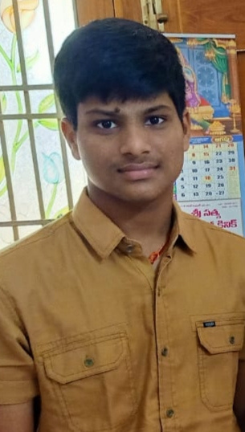


MEET OUR TEAM
TECH TITANS
lalith prakash
isha medeeha
Praneeth goud
lalith kumar
zaid khizar
Nithin varma

Slide 16
TECH TITANS
THANK YOU

